Slide 1
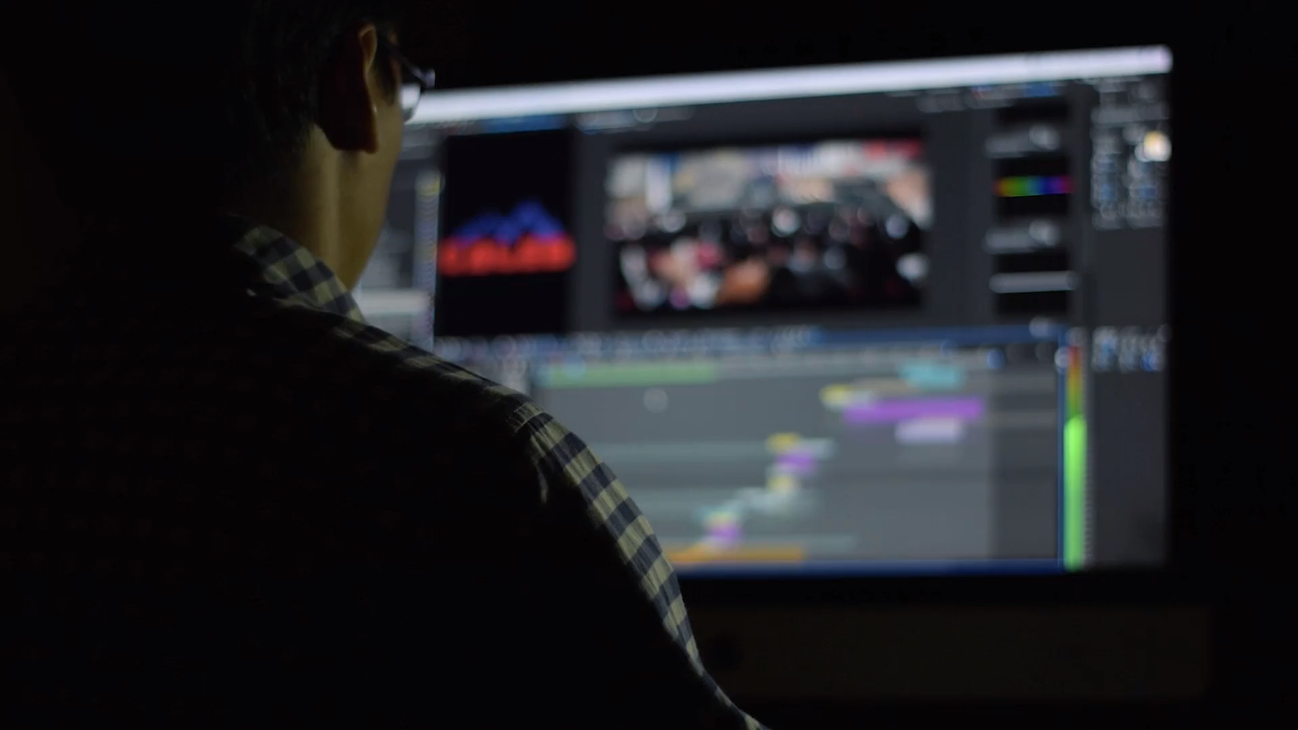
AVR
AUTOMATED VIDEO REFRAMER

Slide 2




STATISTICS
70%
85%
Short-Form Consumption
Engagement Boost
Percentage of video consumption that is short-form content.
Marketers seeing higher engagement with short videos.
60%
Workload Reduction
AI-based editing tools reduce the workload.
(Statista,2023)
(HubSpot,2023)

Slide 3
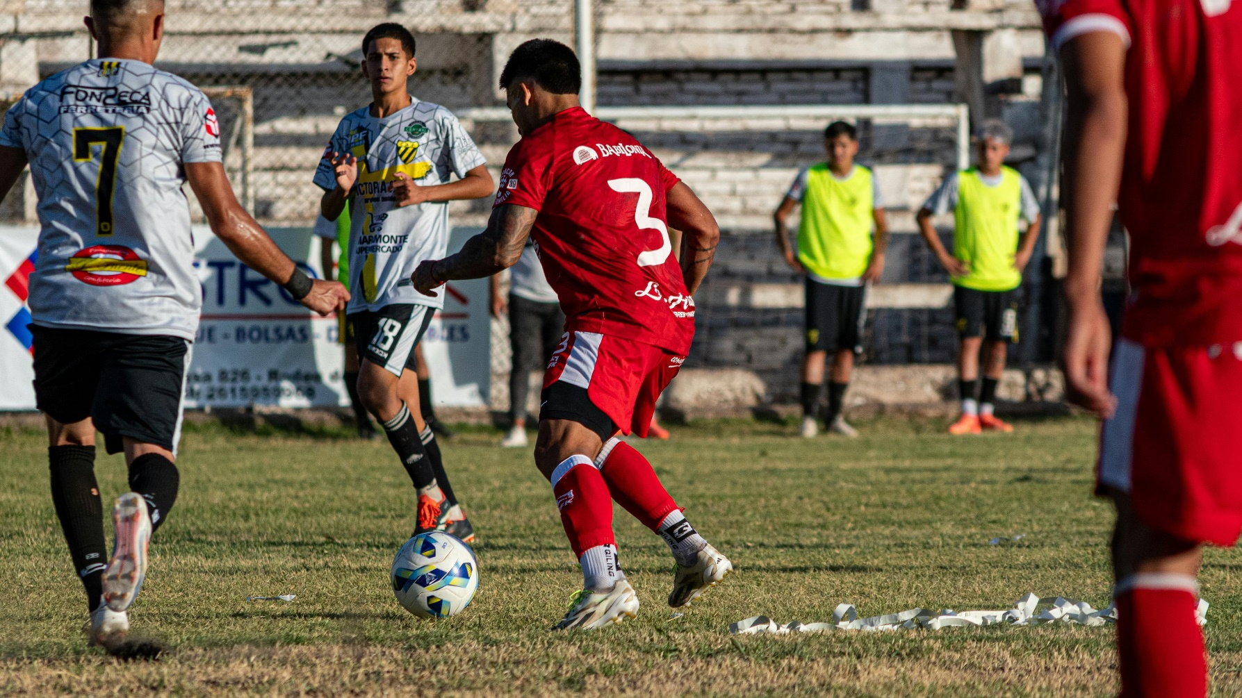
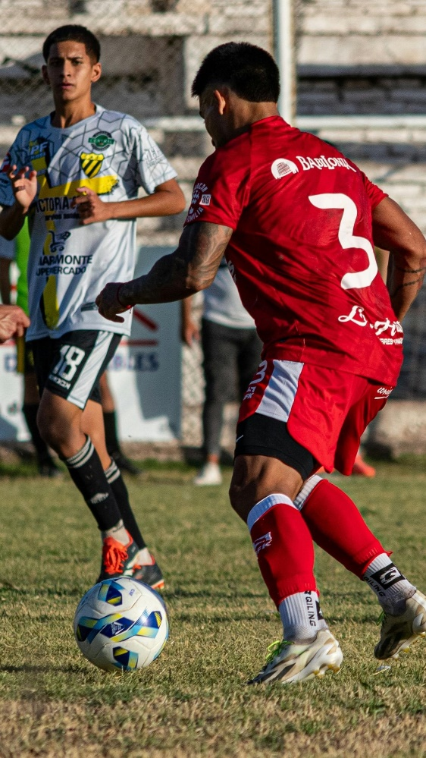
PROBLEM STATEMENT
1
Manual editing of long videos into shorts is time-intensive and requires expertise
2
Maintaining focus on a specific subject in a video is challenging without advance tracking tool
3
Manual editing can take up to 10x the length of the actual video for inexperienced users
4
Creators lack an easy-to-use tool that can automatically generate high-quality short clips from long videos.
ORIGINAL VIDEO (16:9)
RESULT
(9:16)

Slide 4



Introduction
AI-Powered Video Reframing: Extracts key moments from long videos.
Optimized for Short-Form Content: Ideal for platforms like Instagram Reels and YouTube Shorts.
Intelligent Subject Tracking: Ensures high-quality, well-framed clips.
Time-Saving for Editors: Automates the editing process.
Automatic Segmentation: Breaks long videos into 1-minute clips while maintaining focus and relevance

Slide 5




WHY IS THIS NEEDED?
Short Content
Manual Editing
AI Automation
Subject Tracking
Viewers now prefer short and high-quality content. They don't have time for long videos.
Content creators struggle with manual editing. This process is often very time-consuming.
AI automation simplifies the editing process. It also maintains high levels of viewer engagement.
Keeping the main subject in focus throughout a video requires constant adjustments, making manual editing difficult.

Slide 6




Scope of the Project
Target Audience
Content creators, editors, and marketers are the target.
Core Features
AI reframing and intelligent video segmentation are key.
Future Enhancements
Expect advanced AI tracking and better output quality.

Slide 7
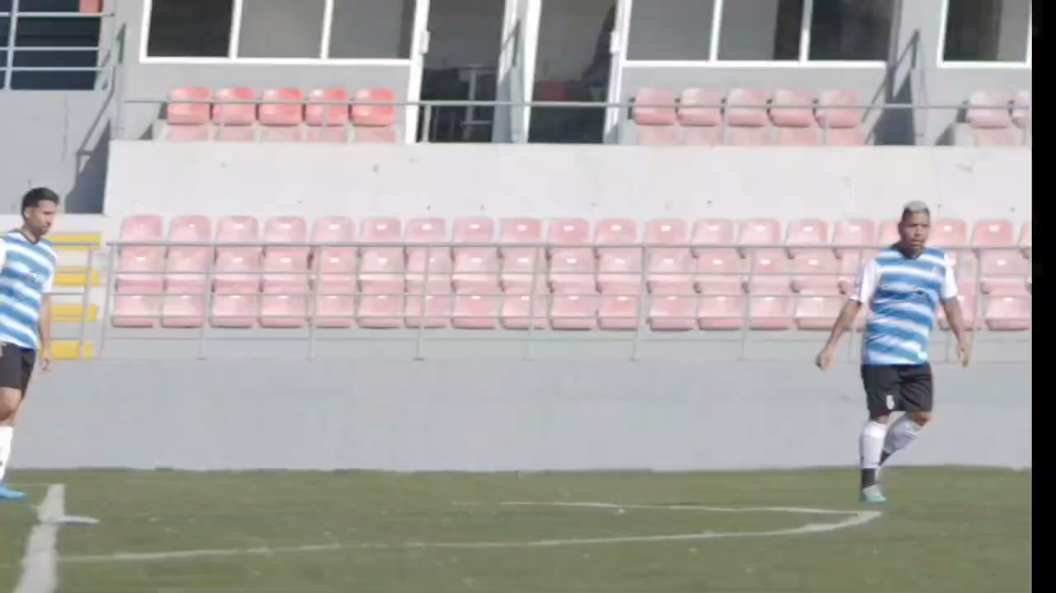
GOALS AND OBJECTIVES
1
Extract meaningful clips from longer videos.
2
Ensure the main subject remains in focus.
3
Use of ai mechanism to reduced workload and completing task efficiently.

Slide 8
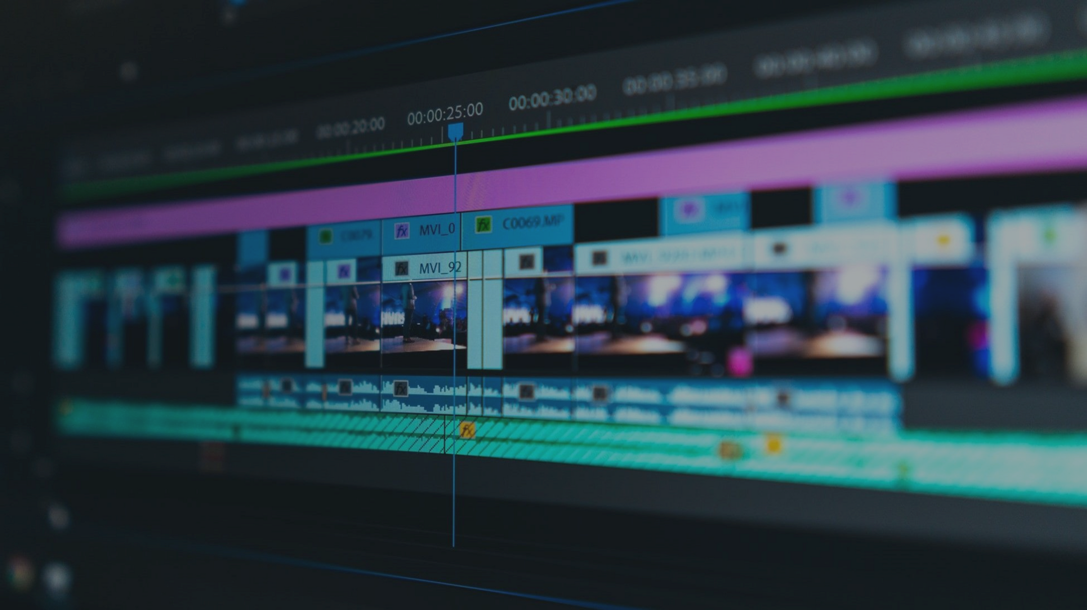
PROJECT MODULES

Slide 9







User Interface Module
Video Upload Module
Preprocessing Module
Subject Detection and Tracking Module
Clipping Module
Provides a user-friendly GUI for uploading videos and configuring output preferences.
Handles the upload of video files in various formats.
Prepares video data by adjusting resolution, format compatibility, and frame extraction.
Uses AI to identify and track the main subject (person) throughout the video.
Segments long videos into short clips while maintaining continuity and relevance.
Merging
Export Module
Quality Module
Manage Module
Frame Extractiony
Combine two or more videos into a single video.
Outputs processed videos in social media-friendly resolutions and aspect ratios (9:16, 1:1).
Ensures that the output meets predefined quality standards (e.g., resolution).
Allows users to manage the processed shorts videos.
Use as few video frames as possible to represent as much video content as possible

Slide 10



Hardware Requirements
Client Side
Processor Dual Core or above
RAM 4 GB
Disk space 10 GB (SSD)
Monitor Desktop/laptop/ tab/ mobile
Network
Other
Internet Connection
Keyboard/mouse
Developer Side
Processor Quad Core or above (2 GHz or
more)
RAM 8 GB or above
Disk space 500 GB (SSD)
Monitor Desktop/Laptop
Network Internet Connection

Slide 11
Software Requirements
Client Side
Web Browser (Google Chrome, Firefox, IE9 or above)
Windows 7 or above / Linux / Android / IOS
Developer Side
Operating System: Windows 10 or above /Linux
Web Browser: Chrome / Firefox / Edge
IDE: VS Code
Programming Language: Python
Runtime Environment: Miniconda
Backend Framework: Flask
Database: sql alchemy
Version Control System: Git

Slide 12





Conclusion
The Automated Video Reframe Tool is revolutionary.
It reduces time and enhances engagement.
It ensures high-quality video output.
The tool achieves all of this with AI-driven automation.

Slide 13



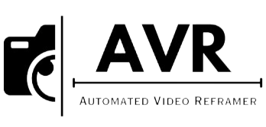




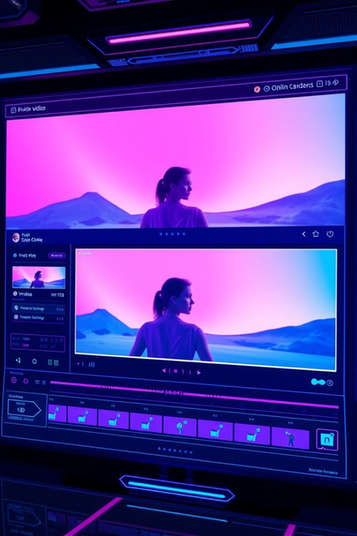

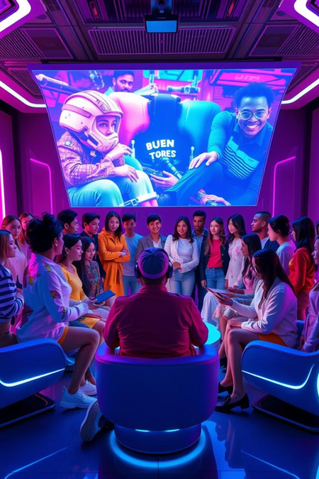


THANKYOU

